Slide 1
To study the function of a protein, you must be able to separate it from the complex protein mix in animals.
This usually begins with getting it into solution, soaps can help if it is not water soluble (what kinds of proteins are not fully water soluble?).

Slide 2
Once in solution, there are two main ways for proteins to be separated.
  Separation based on physio-chemical properties
  Separation based on size

Slide 3
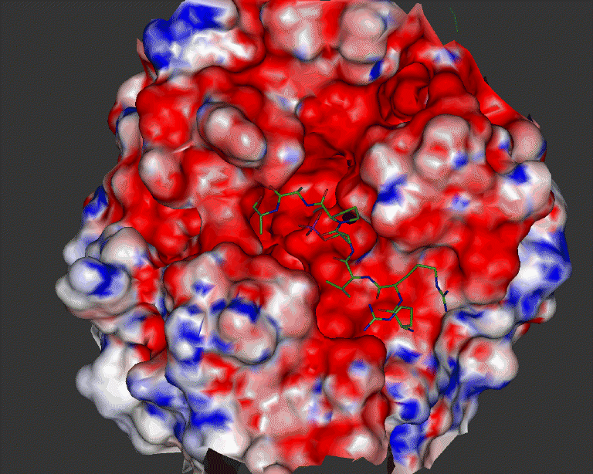
Physiochemical Separations
The most common classes of chemical separation exploit differences in solubility (hydrophobicity/hydrophilicity) and charge states.

Slide 4
Physiochemical Separations
The most common classes of chemical separation exploit differences in solubility (hydrophobicity/hydrophilicity) and charge states.
  Various concentrations of mixed organic/aqueous solvents can be used to partition proteins based on their relative solubility.

Slide 5
Physiochemical Separations
The most common classes of chemical separation exploit differences in solubility (hydrophobicity/hydrophilicity) and charge states.
  Various concentrations of mixed organic/aqueous solvents can be used to partition proteins based on their relative solubility.
  Salts can be added so that the ionic strength of the solution will increase and ions will essentially cover the ionic residues on amino acids and cause them to fall out of solution.

Slide 6
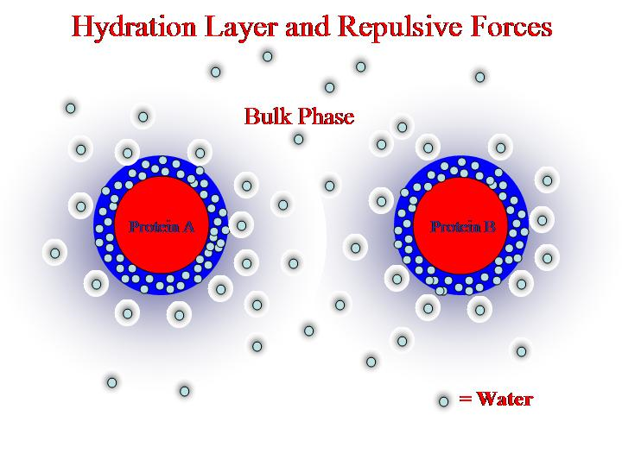
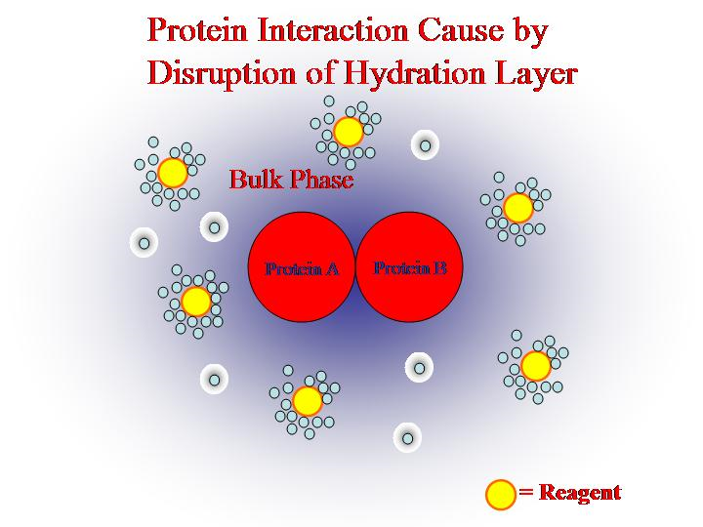
“Salting” proteins out of solution
The ionic reagent (e.g., ammonium sulfate) interacts with
water preferentially, pulling the water away from the protein.
The protein then becomes insoluble and precipitates out.

Slide 7
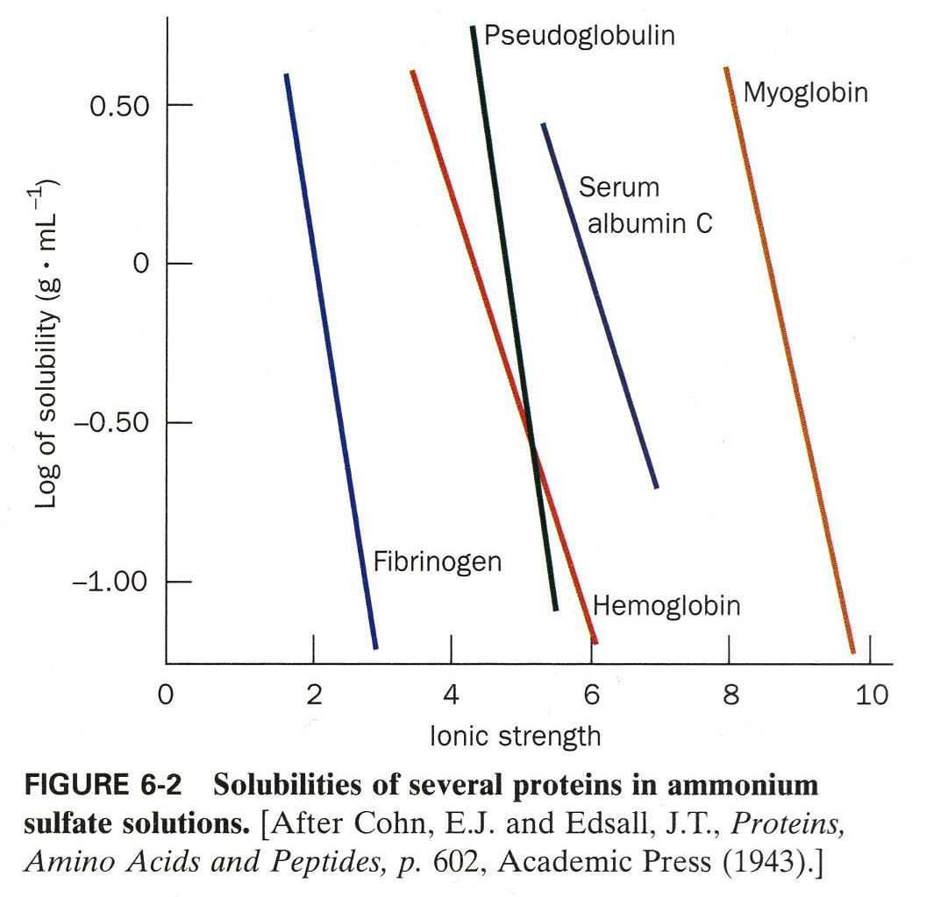

Slide 8
Physiochemical Separations
The most common classes of chemical separation exploit differences in solubility (hydrophobicity/hydrophilicity) and charge states.
  Various concentrations of mixed organic/aqueous solvents can be used to partition proteins based on their relative solubility.
  Salts can be added so that the ionic strength of the solution will increase and ions will essentially cover the ionic residues on amino acids and cause them to fall out of solution.
  The pH of the solution can be changed which will affect the ionization states of the amino acids in the protein changing its solubility.

Slide 9
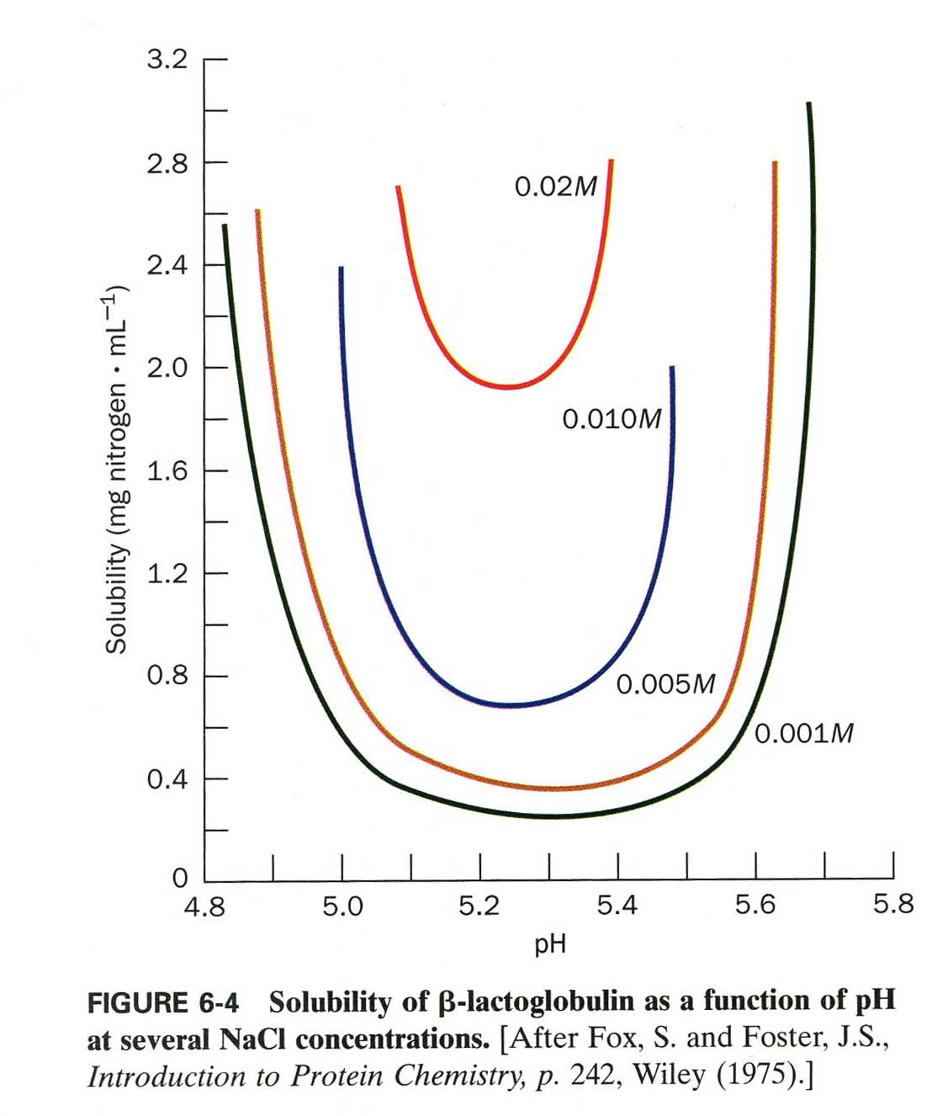
Methods can also be combined to improve separation

Slide 10
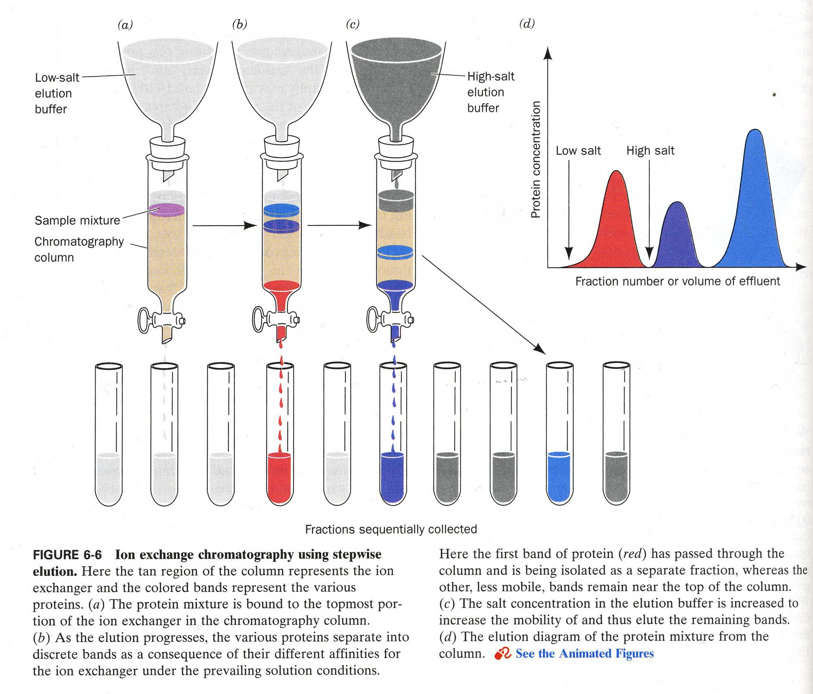
Liquid phases can be combined with solids to improve extraction

Slide 11
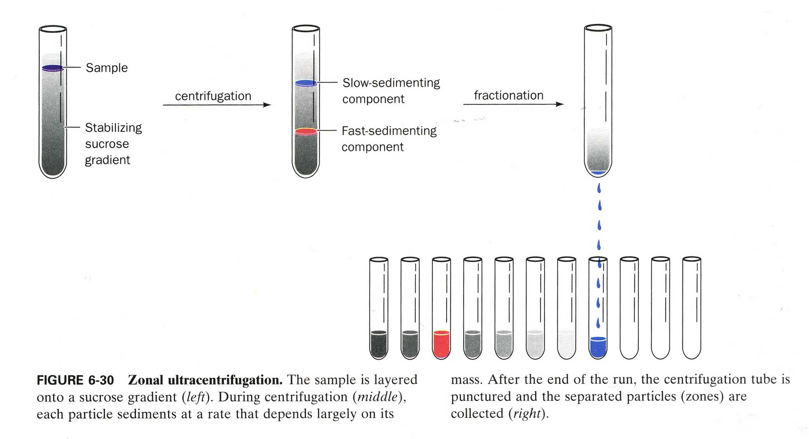
Separations by Size
Density-gradient Ultracentrifugation – protein mix is placed in a solution of differing density and spun at high speeds.

Slide 12
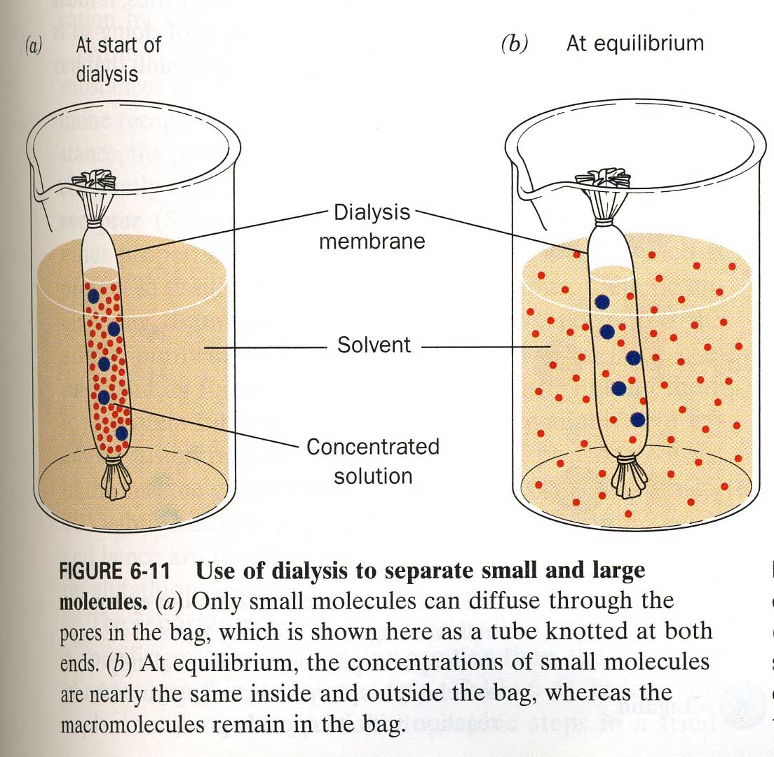
Separations by Size
Dialysis – protein
mix is placed in a bag with holes of
a certain size and smaller proteins and other
molecules
diffuse out.

Slide 13
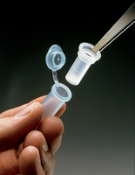
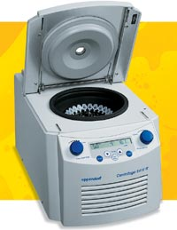
Separations by Size
Membrane Exclusion Centrifugation – place sample in a centrifuge tube with a membrane in the middle with certain size pores. All things smaller will pass through larger things will not.

Slide 14
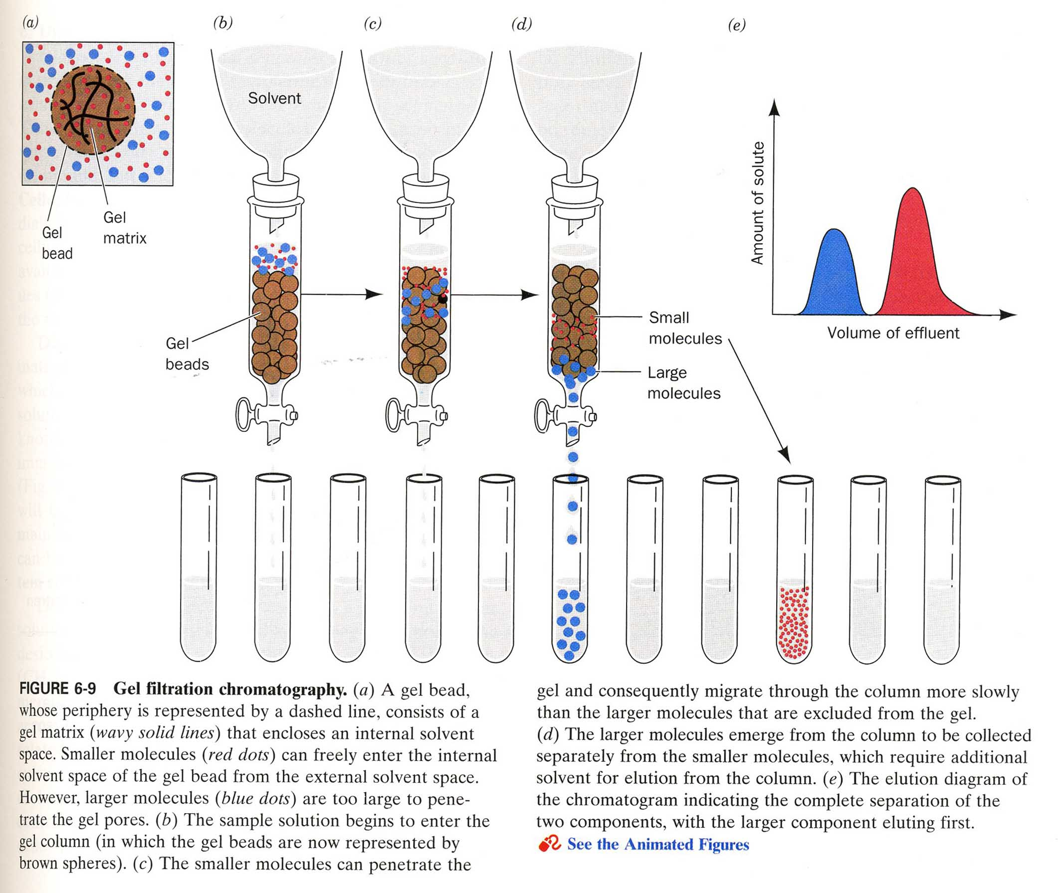
Separations by Size
Gel-filtration Chromatography – gel beads with pores in them that allow smaller molecules to enter the pores and smaller molecules are washed out more slowly.

Slide 15
A method that combines physiochemical and size methods is electrophoresis – moving proteins through a solid matrix using an electric current.

Slide 16
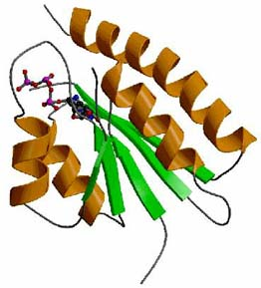
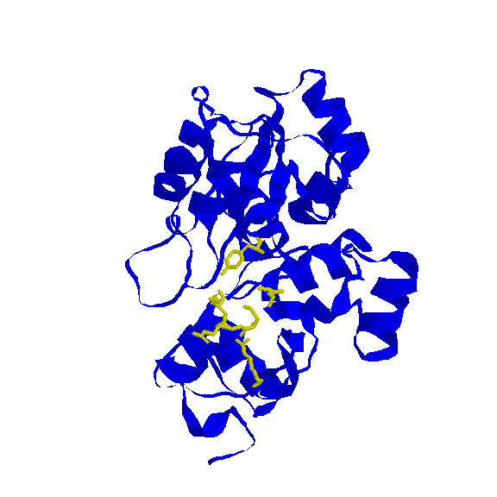
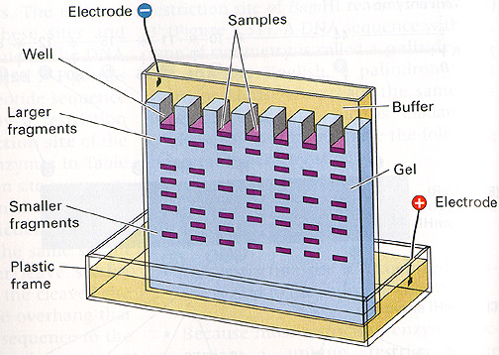
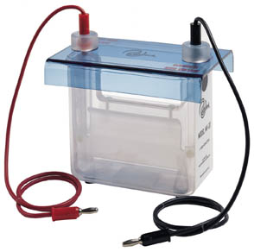
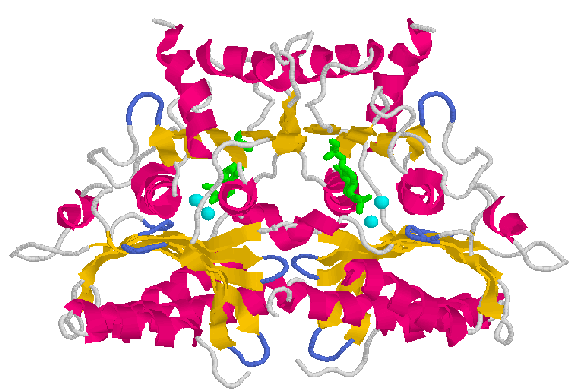
SDS - PAGE
Sodium Dodecyl Sulfate Poly Acrylamide Gel Electrophoresis by
Jacqueline Dawany
With modification by Luis Matos

Slide 17
Applications of SDS-PAGE
Separate/ Purify Proteins
Estimate Protein Size
Assess Protein Purity

Slide 18
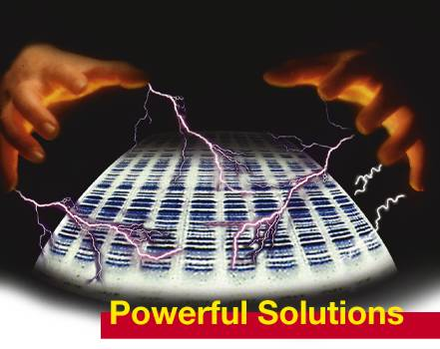
SDS-PAGE…
Electrophoresis
Electrophoresis is the
process by which charged
molecules are separated in
an electrical field because of
their differential mobilities.
-
+

Slide 19

Factors That Affect Mobility
Size / Shape of protein molecule
Charge of molecule
Size of pores in supporting medium
Voltage Gradient

Slide 20
Mobility Factor
Shape of Protein
Size of Protein
Charge of protein
Pore Size of gel
Voltage / electric current
Controllability
Yes
No
Yes
Yes
Yes
When all other factors are made to be uniform, proteins can be separated based on their size alone.
The components of SDS-PAGE all contribute to the control of the variable factors.

Slide 21
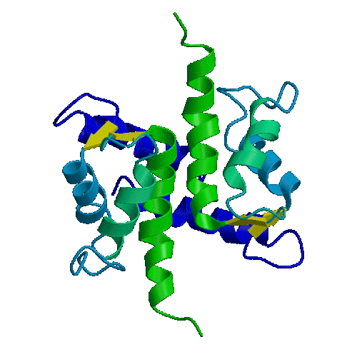
3 Important Components of
SDS-PAGE
Laemmli Sample Buffer
Electrode Buffers
Poly-Acrylamide Gel

Slide 22
Laemmli Buffer: for storage of samples containing proteins. Helps to create a uniform charge and shape among proteins.
Component | Description
Tris | Buffer (pH 6.8)
SDS | Anionic Detergent
Mercaptoethanol | Reducing Agent
Glycerol | Dense Molecule
Bromophenol Blue | Biological Dye

Slide 23
Electrode Buffers: Buffers are placed into the electrophoresis unit. They should contain ions to carry a current, and should also help maintain uniform charge and shape among proteins.
Component | Description
Tris | Buffer (pH ~ 8)
SDS | Anionic Detergent
Tricine/Glycine | Electrolyte to carry current

Slide 24
PolyAcrylamide Gel: The supporting gel matrix should form pores of a controlled and uniform size.
Component | Description
Gel Buffer | Tris & SDS
Mono-Acrylamide | Forms linear polymers
Bis-Acrylamide | Cross-linking agent
Ammonium Persulfate | Disulfate ester of Hydrogen Peroxide
TEMED | Tertiary Amine

Slide 25

Tris Buffer
At low pH (pH<5) most proteins will have a net positive charge because the amino groups are all ionized while the carboxyl groups are not.
At higher pH (pH>8) most proteins carry a net negative charge due to the ionization of the carboxyl groups but not the amino groups.
Base
Neutral
Acid

Slide 26
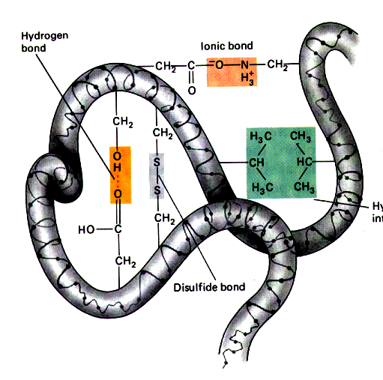
SDS: Sodium Dodecyl Sulfate
SDS is an anionic detergent which binds to the hydrophobic side chains of amino acids at a constant ratio. In doing so, it coats proteins with negatively charged molecules.
This ensures that the proteins have a similar charge:mass ratio, eliminating the intrinsic charge as a factor affecting migration.
SDS also interrupts ionic interactions among the side groups of amino acids, ultimately destroying its 3D shape.

Slide 27
Mercaptoethanol: Reducing Agent
Reduction can be either the loss of one oxygen, or the gain of two hydrogens.
In this case, the addition of two hydrogens will break the disulfide bonds that hold a protein in it’s 3D shape

Slide 28
Glycerol
Glycerol is a dense molecule. It is added to samples which are to be electrophoresed so that they will sink to the bottom of the wells as they are pipetted into the gel.

Slide 29
Bromophenol Blue
Bromophenol Blue is a negatively charged biological dye of low molecular weight
BPB migrates faster than proteins and can be seen traveling through the gel
It is used to track the migration progress so that the unit may be turned off before the proteins run off the gel

Slide 30
MonoAcrylamide
CH₂=CH-CONH₂:
In the presence of free radicals, monoacrylamide polymerizes in linear chain. Varying the concentration of acrylamide will determine how tightly packed the polymer chains will be.

Slide 31
BisAcrylamide
CH₂=CH-CONH-CH₂-CONH-CH-CH₂:
In the presence of free radicals and mono-acrylamide, bis-acrylamide cross-links with the linear polymer chains formed by mono-acrylamide. Varying the concentration of bis-acrylamide will determine the extent of cross-linking (which determines pore size)

Slide 32
Ammonium Persulfate
NH₄S₂O₈ : Ammonium Persulfate is a disulfate ester of hydrogen peroxide which readily homolyzes into unstable SO₄- radicals.
The radicals then react with TEMED to form TEMED free radicals.

Slide 33
TEMED: Tetra-ethyl methylene diamine
TEMED is a tertiary amine which forms TEMED free radicals in the presence of free radicals from ammonium persulfate.
TEMED free radicals react with acrylamide to induce polymerization.

Slide 34
The two gels
The stacking gel
  Lower acrylamide concentration
  Larger pores
  Proteins travel fast
Resolving gel
  Higher acrylamide concentration
  Smaller pores
  Proteins travel more slowly

Slide 36
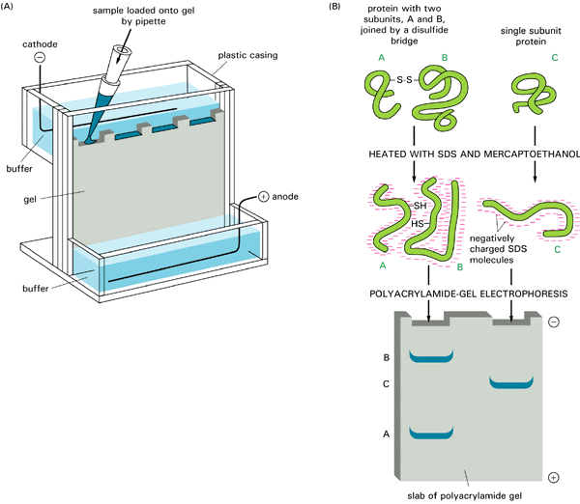

Slide 37
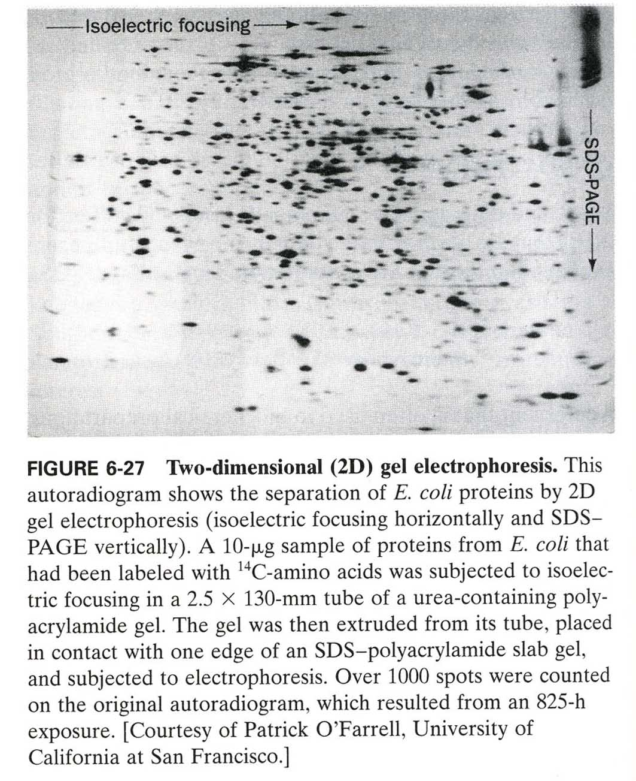
pH
Size
Electrophoretic
methods can be
combined to
improve
separations.

Slide 38
What are we trying to do today?

Slide 39
What are we trying to test today?
Whether composition in the blood differs between feeding Mnduca larvae and adult male flesh flies.
Arylphorin is an insect amino acid storage protein.

Slide 40
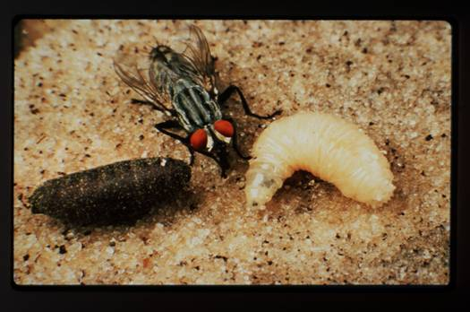
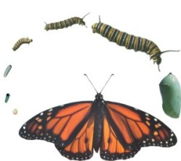
Food in midgut
Amino Acids in Hemolymph
Amino Acids used to Produce Arlyphorin
in Fat Body
Arylphorin Secreted out into the Blood
until Metamorphosis
Amino Acids Liberated from Arylphorin to
Build Adult Proteins During the
Non-feeding Pupal Stage

Slide 41
Storage Protein Levels in Blood Through Development
Storage Protein µg / µl Blood
1
2
3E
3M
3L
1
2
3
P
PH1
PH2
PH3
Feeding
Larva
Wand.
Larva
Pharate
Adult
Pupa

Slide 42
Females Contain More Storage Protein
at Eclosion, Before Feeding
P<0.001
**P<0.001

Slide 43
Females Contain More Storage Protein in Adulthood
Female
Male

Slide 45
Storage Proteins
Egg Length
Error Bars are Subsumed Within Some Points

